Slide 1

EPMAward
17th EPMeeting
Catania, Italy,
23th-01st September 2012
Laura Patanè
Liceo Boggio Lera, Catania, Italy

Slide 2
Problems...
Scores
Money

Slide 3
Last scores...
voters | confirmed voters | Validated votes | valid Votes
3.520 | 1.798 | 248 | 91

Slide 4
Do you plan to participate at the cost of next EPMAward 2010\2011 and 2011\2012?

Slide 5
The Last EPMeeting
What can we do?
Maintain EPMAward sharing the cost
Send a diploma to the winner
Close EPMAward
Or ...

Slide 6
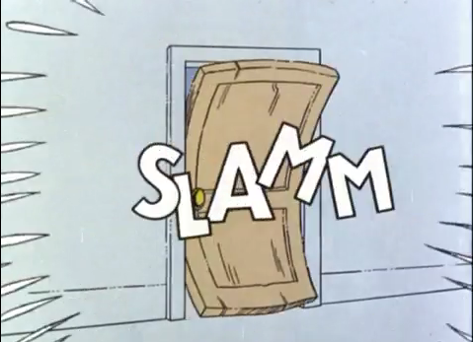
My opinion
Close
EPMaward

Slide 7

Why?
Nobody want to share the cost of the EPMaward
There are too much fake votes

Slide 8
What are your propose?
…
…
…
…

Slide 9
Thank you for attention!

